Slide 1
Fact Tables Basics
Radoslav Golian
10.10.2018

Slide 2
Fact Tables and Processes
Each process should have its own fact table
Decomposition
Sales process
Proposals
Order entry
Shipment
Invoicing
Returns management

Slide 3
Fact Separation
Do we need multiple fact tables?
Do the facts occur simultaneously?
Are the facts available at the same level of grain?
If the answer to either question is “no”, the facts represent multiple processes
Example: quantity ordered, quantity shipped

Slide 4
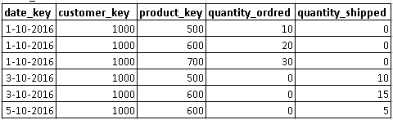
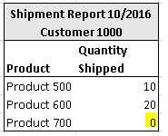
Different Timing
Facts
Quantity ordered by Date, Customer, Product
Quantity shipped by Date, Customer, Product
Zero-valued Facts
Common when multiple processes are modeled in a single fact table
SALES_FACT

Slide 5


Different Timing
“Solutions”
NULL instead of 0
HAVING sum(quantity_shipped) > 0 is not a solution
WHERE quantity_shipped > 0
WHERE quantity_shipped IS NOT NULL
Generic fact (additional dimension)
SALES_FACT
FACT_TYPE

Slide 6


Different Timing (Separation)
SALES_FACT
ORDERS_FACT
SHIPMENTS_FACT

Slide 7
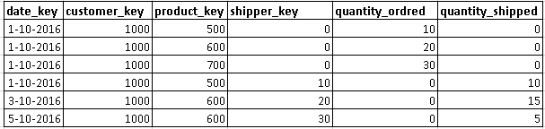
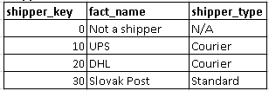
Different Grain
Facts
Quantity ordered by Date, Customer, Product
Quantity shipped by Date, Customer, Product, Shipper
If the order and shipment is on the same day we need to insert two rows
An order has no shipper, a shipment has a shipper
SALES_FACT
SHIPPER_DIM

Slide 8
Different Grain
The same “solutions”
Filtering out NULL/0 values
Generic facts
NULL in FK may require an outer join to study the process
The correct solution is a separation of the facts into separate tables
Optional relationships are not a problem
Different grain is a problem
One fact involves shipper, the other does not

Slide 9


Different Grain (Separation)
SALES_FACT
ORDERS_FACT
SHIPMENTS_FACT

Slide 10
Example
orders_fact
date_order_key
product_key
customer_key
quantity_ordered
..
order_euros
…
order_id
order_line_num
shipments_fact
date_order_key
date_shipment_key
product_key
customer_key
shipper_key
..
quantity_shipped
cost_euro
revenue_euro
margin_euro
…
order_id
order_line_num
shipment_id
shipment_line_num
date_dim
product_dim
customer_dim
shipper_dim

Slide 11
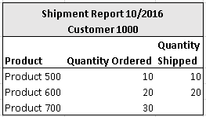
Analyzing Facts (More Tables)
Drill across
Proper way how to compare two processes
ORDERS_FACT
SHIPMENTS_FACT

Slide 12


Analyzing Facts (More Tables)
ORDERS_FACT
SHIPMENTS_FACT
Orders Query
Shipment Query
Merge on common dimensional attribute(s)
Ratios may be computed

Slide 13
Drill Across
Phase 1: a separate query for each fact table
Get same dimensions in each query
Summarize facts by chosen dimensions
Phase 2: combine the result sets
Perform full outer join based on common dimensions
Compute comparisons or ratios of facts if desired

Slide 14
Drill Across (Query example)
SELECT coalesce(ord.date_key, ship.date_key) date_key,
coalesce(ord.customer_key, ship.customer_key) date_key
ord.ordered,
ship.shipped,
round(100 * ord.ordered / ship.shipped, 2) ratio_pct
FROM (
SELECT d.date_key, c.customer_key, sum(o.quantity_ordered) ordered
FROM orders_fact o
INNER JOIN customers c ON (o.customer_key = o.customer_key)
INNER JOIN date_key d ON (o.date_key = d.date_key)
...
WHERE ...
GROUP BY d.date_key, c.customer_key) ord
FULL OUTER JOIN (
SELECT d.date_key, c.customer_key, sum(o.quantity_shipped) shipped
FROM shipment_fact s
INNER JOIN customers c ON (s.customer_key = o.customer_key)
INNER JOIN date_key d ON (s.date_key = d.date_key)
...
WHERE ...
GROUP BY d.date_key, c.customer_key) ship
ON(ord.date_key = ship.date_key AND ord.customer_key = ship.customer_key)

Slide 15
Summary
Separate processes should be measured in separate fact tables
When unsure, check timing and grain of the measured facts
When multiple processes are described in a single fact table, analysis of a single process is hampered
Proper way to combine information from multiple fact tables is drill across

Slide 16
Conformed Dimensions
Radoslav Golian
10.10.2018

Slide 17
Conformed Dimension
Dimensions are the key enablers of drilling across
Incompatible dimensions prevent drilling across and process comparison
Conformed dimensions are common dimensions for all star schemas in DWH

Slide 18
Non Conformed Dimensions
Consequences (some of them)
Specific knowledge is required to drill across
It may be possible only for the most skilled developers to use workarounds to compare the processes
Workarounds risk inconsistent and inaccurate results

Slide 19
Preliminary Requirements
Requirements for conformance
Same structure
Same set of dimension columns
Columns should have the same names and types
Same content
Values found in dimension columns must be expressed identically
The same set of rows: corresponding rows share the same surrogate keys
Identical tables are not required

Slide 20
Example
salesrep_dim
salesrep_key
territory
territory_code
territory_manager
region
region_code
…
territory_dim
territory_key
territory
territory_code
territory_manager
region
region_code
…
order_facts
date_order_key
product_key
customer_key
salesrep_key
quantity_ordered
..
order_euros
…
order_id
order_line_num
sales_goals_fact
month_key
version_key
territory_key
goal_euos
..
day_dim
date_key
full_date
…
month
month_number
fiscal_period
year
…
month_dim
month_key
month
month_number
fiscal_period
year
…

Slide 21
Types of Conformance
Shared Dimension Tables
Tables have the same structure and content
When there is more than one copy of a shared dimension a singe ETL/ELT process should be responsible for processing new and changed data
Conformed Rollups
The dimension attributes of one table are a subset of dimension attributes of the other
The common dimension attributes share the same structure and content
Example: day dimension and month dimension

Slide 22
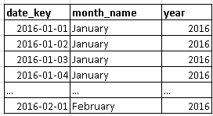

Conformed Rollups
DATE_DIM
MONTH_DIM

Slide 23
Types of Conformance
Conformed Degenerate Dimensions
order_id, order_line_num
Overlapping Dimensions
Intersecting attributes (usually maintained by separate ETL/ELT processes)
Creating a Third Table to Avoid Overlap
Creating a Third Table as an Outrigger

Slide 24
Overlapping Dimensions
salesrep_dim
salesrep_key
territory
territory_code
territory_manager
region
region_code
…
customer_dim
customer_key
territory
territory_code
territory_manager
region
region_code
…
territory_dim
territory_key
territory
territory_code
territory_manager
region
region_code
…

